Slide 1
Possibilities. Anywhere.
Maritime Customer Support
Lars Vestby, 1st Sept 2024

Slide 2
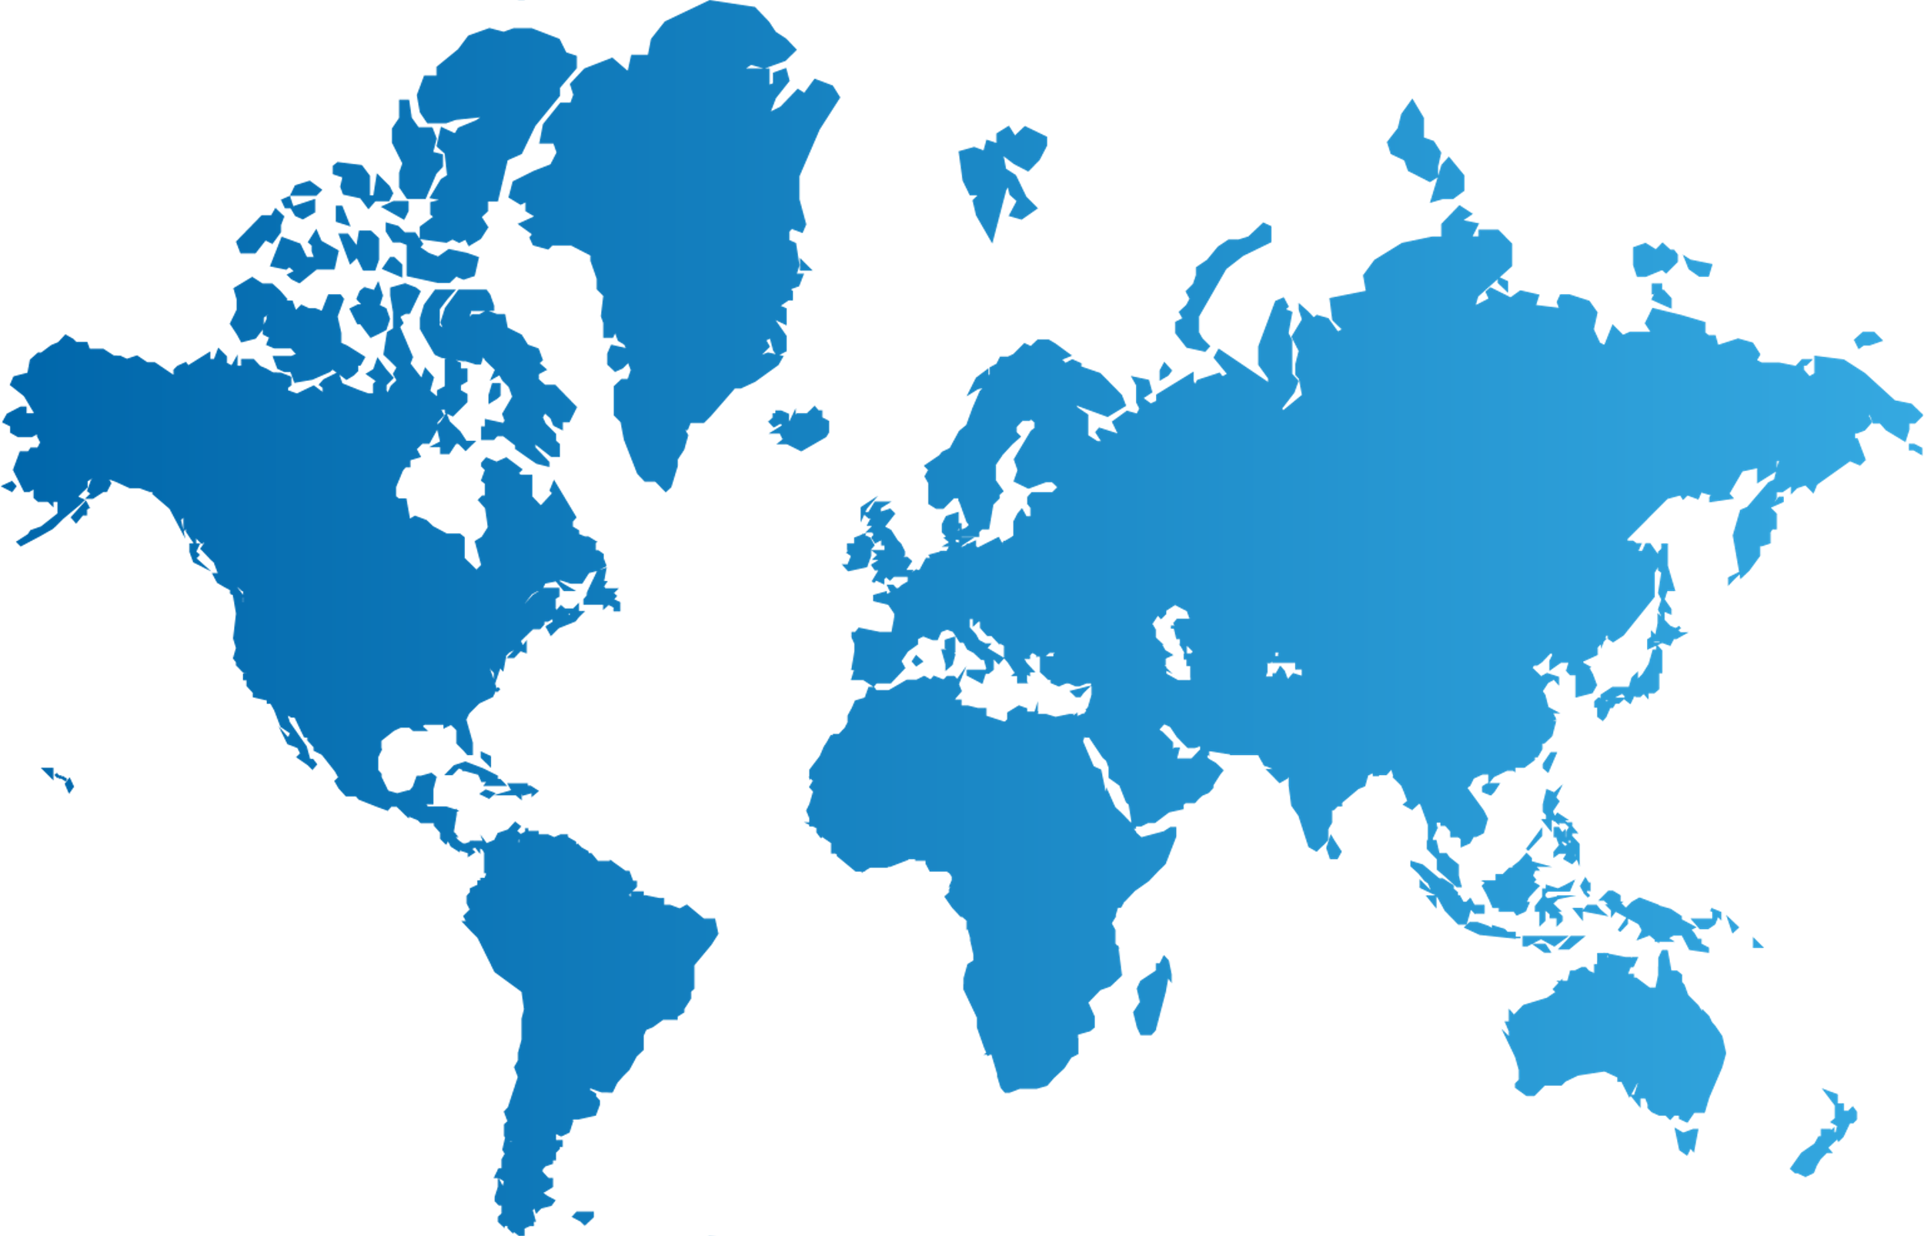
1st Level Support : Regional Customer Support
The RCS Teams are Delivering 24/7/365 Coverage & Support Globally
Efficient handling of Incidents and Requests
24/7 support for all product and solution areas
Manage and resolve most requests and incidents “one touch” by having as much competence in the customer front as possible
Fast transfer to expert teams if needed
Ticket ownership
RCS have ticket ownership for request / incidents until closure and monitor tickets as they flow through RCS and 2nd or 3rd level support
Each RCS team are accountable for their local customer base and are responsible for individual customer focus
Local support with global reach
Offices in Houston, Bratislava, Athens, Dubai, Singapore, Tokyo and Rio de Janeiro(under setup)
All RCS teams are working dayshifts in a 7 days rotation
The RCS Cyprus/Greece team has an extended availability 24/7/365
Houston
Bratislava
Athens
Tokyo
Dubai
Singapore
Rio de Janeiro

Slide 3
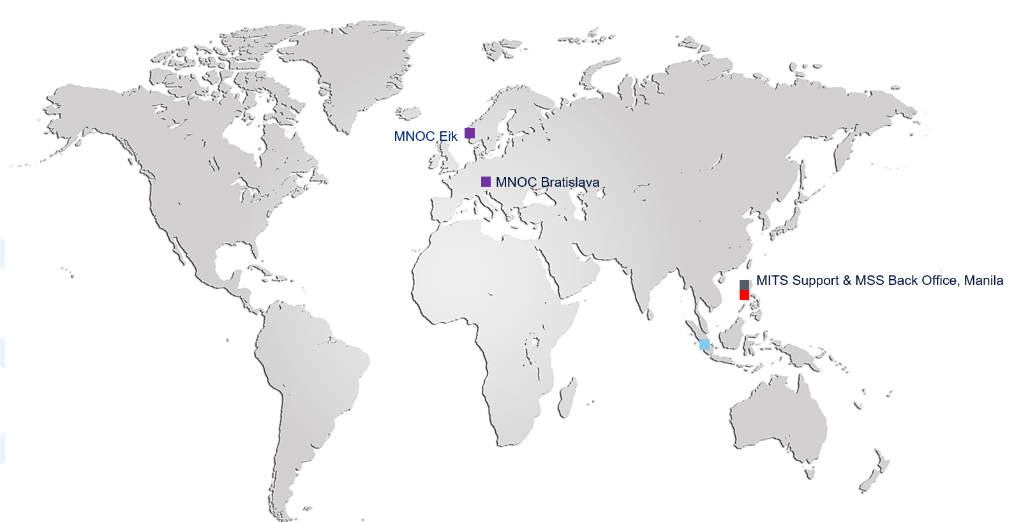
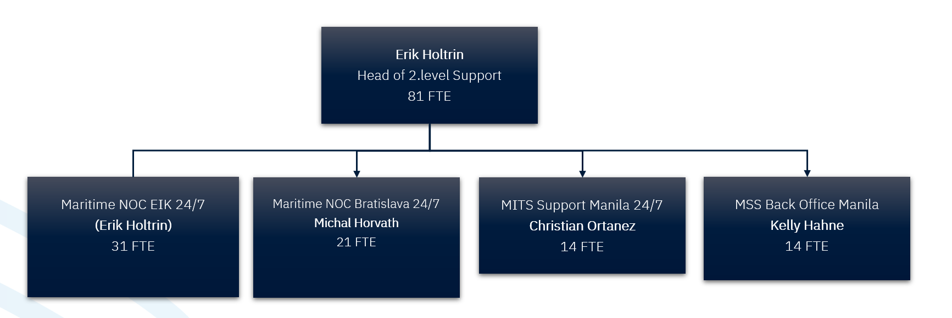
2nd Level Support : Managed Services & Network Operations (MS&NOC)
All 2nd level teams are 24/7, >80 staff, 3 locations:
24/7 Maritime NOC in Eik, Norway
2nd Level Connectivity support (VSAT, Starlink/LEO, LTE) for Customized Solutions
2nd Level Network Support and Network Management
2nd Level Antenna / RF Support
Change management (Connectivity)
Reporting & Support tools development
Ordering of Field Engineer call-out and/or ordering of spare part shipment
24/7 Maritime NOC in Bratislava, Slovakia
2nd Level connectivity (VSAT, Starlink/LEO, LTE), antenna/rf & network support for Standard Solutions
Ordering of Field Engineer call-out and/or ordering of spare part shipment
24/7 MITS Support in Manila
2nd level Support for Marlink IT solutions.
24/7 MSS Backoffice in Manila
MSS services activation / deactivations

Slide 4
Marlink Maritime Support, All Locations
Security Operation Centre
Service Manager
3rd line Digital Services
Competence Center Aussaguel VAS/Cyber
3rd line Connectivity
MNOC Eik 24/7
Change Management
MITS Support Manila 24/7
MSS back-office Manila 24/7
MNOC
Bratislava 24/7
RCS America
Houston
RCS Europe
Bratislava
RCS Southeast Asia
Singapore
RCS Greece/Cyprus
Athens
RCS Japan
Tokyo
RCS Middle east & Africa
Dubai
Customer
Escalation
Notes:
How will this change impact each team?
Nothing about sizes at first message – correct but I think its important to highlight that we keep support functions and competence in Singapore and Houston (as well as Bratislava, Manila, AUS++)
Answer; Be clear on the structure, locations and responsibilities
Answer; For those not part of the new structure, there will be packages
When can the teams expect more info ? Business as usual until more information with more details are presented.
BRA changed into 24/7, while Houston and Singapore are "just" local offices!
On the contrary, the purpose is to strengthen the local and regional support. The RCS should resolve a large part of the incidents directly
What about Service Desk staff?
RCS teams need to be able to solve incidents on the entire portfolio. So, this is a question about competence, but there will be some specialization within the teams.
Key; ownership of the customers, doing general troubleshooting
Work close with Kelly on the plans for the SD. Most impacted sites are Houston and BRA, while CG will continue pretty much as before. Manila SD to change to MSS backoffice

Slide 5
Present where you need us
Our customer support
Stavanger/Stord Eik/Oslo
Rotterdam
Hamburg
Bratislava
Aussaguel
Palma
Athens
Houston
Tokyo
Dubai
Manila
NOC Maritime / Enterprise
Singapore
MNOC, IT and MSS
Regional Customer Support
Competence Center for IT, VAS, MSS
Service Management
Rio de Janeiro
Security Operations Center
Tier 1 Support for Petrobas

Slide 6
Maritime Customer Support contacts
Regional Support Centres EMEA: +33 1 70 48 53 16 Americas: +1 310 616 5562 Toll free: +1 844 208 0718 Asia Pacific: + 65 31 58 36 38 Japan: +81 50 5050 7990 UAE: 8000 3111270 Email: servicedesk@marlink.com
Greece: +30 210 94 00 377, Email: support.cg@marlink.com
Escalation Level Email address Phone number
Support team leaders Escalation@marlink.com +47 236 790 00 (24/7 assistance)
Support Directors Escalation2@marlink.com +47 236 790 01
VP Maritime Operations Eirik.Haugerud@marlink.com +47 46 62 37 72
President Maritime Tore-Morten.Olsen@Marlink.com +47 908 55 097

Slide 7
RCS Leader Team
with ticket ownership per region
Global Director RCS | Lars Vestby | Lars.Vestby@marlink.com
Team Manager RCS Athens | Antonios Tsotras | Antonios.Tsotras@marlink.com
Team Manager RCS Bratislava | Rastislav Bavolar | Rastislav.Bavolar@marlink.com
Team Manager RCS Dubai | Moutaz Abdalla | Moutaz.Abdalla@marlink.com
Team Manager RCS Houston | Juan Velazquez | Juan.Velazquez@marlink.com
Team Manager RCS Singapore | Guanglin Si | Guanglin.Si@marlink.com
Team Manager RCS Tokyo | Wilko Visser | Wilko.Visser@marlink.com

Slide 8
High level Operation Organization as of Sept 2024
Maritime Operations Eirik Haugerud
Operational Services Juraj Baros
Project Office Marek Lipka
Network Delivery Hans Kristian Funderud
Field Service Gisle Asbjørnsen
Logistics Geir Sivertsen
Regional Customer Support Lars Vestby
2nd layer Support Erik Holtrin
Service Management Erik Hovden
Competence Centre Luc Feron
Tools Lars C De Moraes
Program Manager Victor Siemonsma
Staffing; ca 270 employees
Locations; 17 offices globally
Notes:
Project office: 30+ project managers
Network Delivery: Implementation group 15 resources
Field service: close to 50 own field engineers, and we have an own field partner program as well
Logistics order office; shipments to customer and RMA process
RCS; 1st line support, 50+ resources
2nd layer support close to 80 resources
Competence Centre for VAS and Cyber close to 20
Service Management 15

Slide 9
Thank you!
Any questions?

